Slide 1
Knowledge in Learning

Slide 2
Inductive Learning
Given the set of all hypotheses, eliminate
each one that is inconsistent with examples.
– The set of all hypotheses is infinite!
– Shrink it yet still be realizable
Current-best-hypothesis search
– Maintain a single hypothesis
– Generalize it for false negatives
– Specialize it for false positives

Slide 3
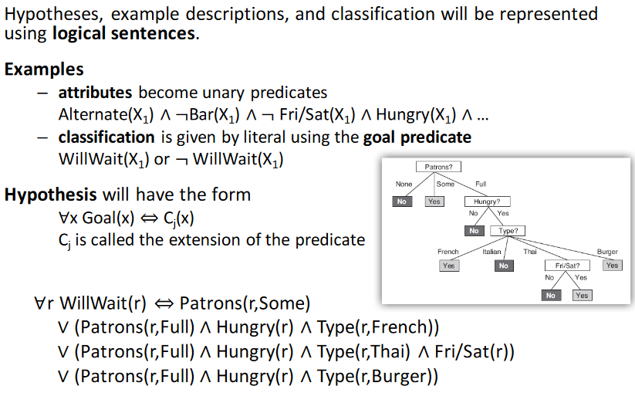
Hypothesis

Slide 4
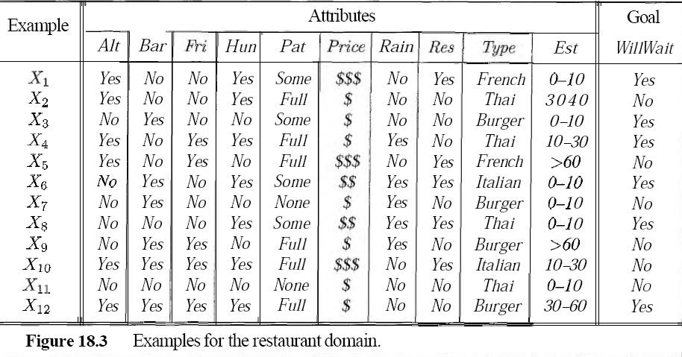
Hypothesis

Slide 5
Explanation
1. Alternate: whether there is a suitable alternative restaurant nearby.
2. Bar: whether the restaurant has a comfortable bar area to wait in.
3. Fri/Sat: true on Fridays and Saturdays.
4. Hungry: whether we are hungry.
5. Patrons: how many people are in the restaurant (values are None, Some, and Full).
6. Price: the restaurant's price range ($, $$, $$$).
7. Raining: whether it is raining outside.
8. Reservation: whether we made a reservation.
9. Type: the kind of restaurant (French, Italian, Thai, or burger).
10. WaitEstimate: the wait estimated by the host (0-10 minutes, 10-30, 30-60, >60).

Slide 6
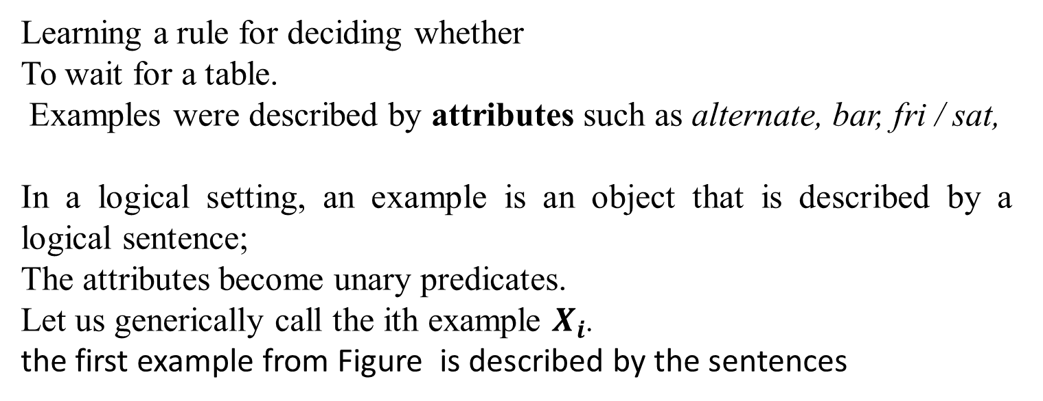
Attribute of Dataset
Learning a rule for deciding whether
To wait for a table.
Examples were described by attributes such as alternate, bar, fri / sat,
In a logical setting, an example is an object that is described by a logical sentence;
The attributes become unary predicates.
Let us generically call the ith example $X_{i}$.
the first example from Figure is described by the sentences
We will use the notation Di(X i)t o refer to the description of Xi, wh ere Dic an be any logical expression taking a single argument. The classification of the object is given by the sentence
Will Wait (XI) .

Slide 7
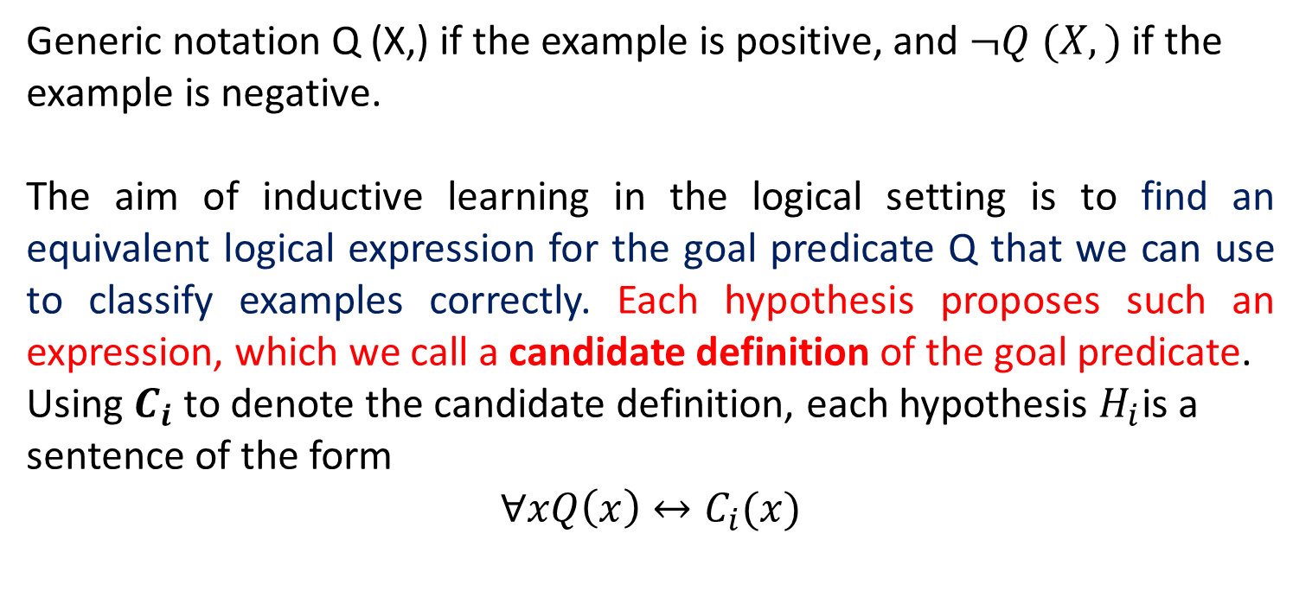
Hypothesis
Generic notation Q (X,) if the example is positive, and $¬Q (X,)$ if the example is negative.
The aim of inductive learning in the logical setting is to find an equivalent logical expression for the goal predicate Q that we can use to classify examples correctly. Each hypothesis proposes such an expression, which we call a candidate definition of the goal predicate.
Using $C_{i}$ to denote the candidate definition, each hypothesis $H_{i}$is a sentence of the form
$$∀xQ\left(x\right)↔C_{i}(x)$$

Slide 8
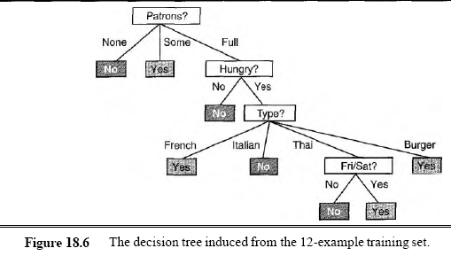
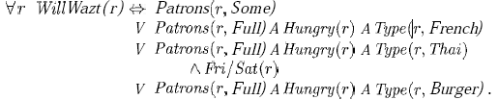

Slide 9
Hypothesis
Each hypothesis predicts that a certain set of examples.
Set of examples that satisfy a candidate definition = extension of the respective hypothesis
Two hypotheses with different extensions are therefore logically inconsistent with each other, because they disagree on their predictions for at least one example.
If they have the same extension, they are logically equivalent.

Slide 10
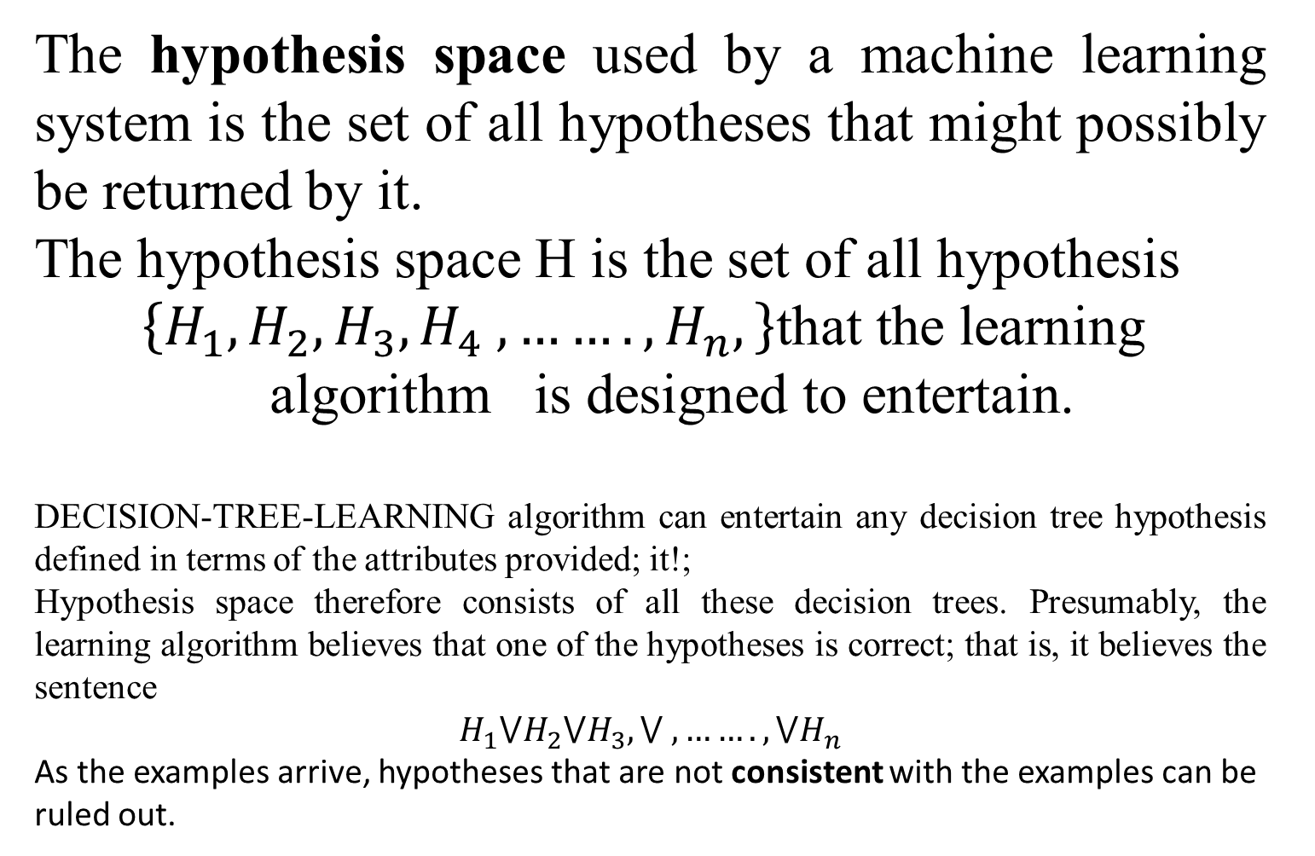
Hypothesis space
The hypothesis space used by a machine learning system is the set of all hypotheses that might possibly be returned by it.
The hypothesis space H is the set of all hypothesis
$$\left\{H_{1},H_{2},H_{3},H_{4} ,…….,H_{n},\right\}\text{that} \text{the} \text{learning} \text{algorithm} \text{is} \text{designed} \text{to} \text{entertain}\text{.}$$
DECISION-TREE-LEARNING algorithm can entertain any decision tree hypothesis defined in terms of the attributes provided; it!;
Hypothesis space therefore consists of all these decision trees. Presumably, the learning algorithm believes that one of the hypotheses is correct; that is, it believes the sentence
$$H_{1}⋁H_{2}⋁H_{3},⋁ ,…….,⋁H_{n}$$
As the examples arrive, hypotheses that are not consistent with the examples can be ruled out.

Slide 11
Learning logicial descripciones
The process of constructing a decision tree can be seen as searching the hypothesis space H. The goal is to construct an hypothesis H that explains the data in the training set.
The hypothesis H is a logical description of the form:
H: H₁ \/ H₂ \/ … \/ H_{n}
H_{i}: ∀x Q(x) <=> C_{i}(x)
where Q(x) is the goal predicate and C_{i}(x) are candidate definitions.

Slide 12
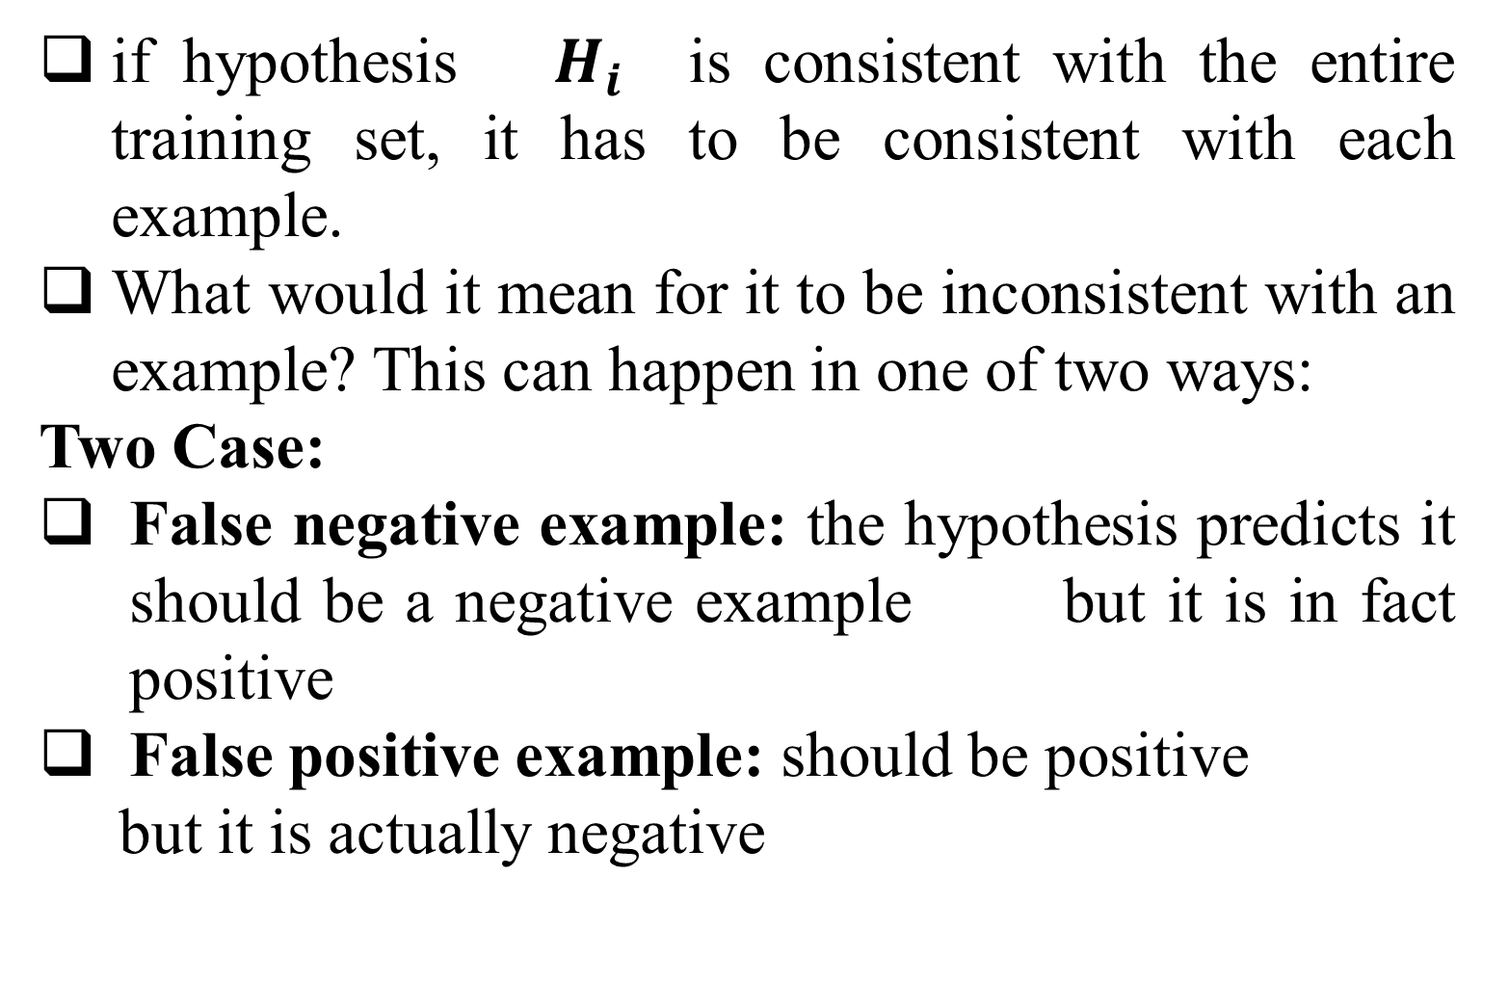
Learning logicial descripciones
if hypothesis $H_{i}$ is consistent with the entire training set, it has to be consistent with each example.
What would it mean for it to be inconsistent with an example? This can happen in one of two ways:
Two Case:
False negative example: the hypothesis predicts it should be a negative example but it is in fact positive
False positive example: should be positive
but it is actually negative

Slide 13
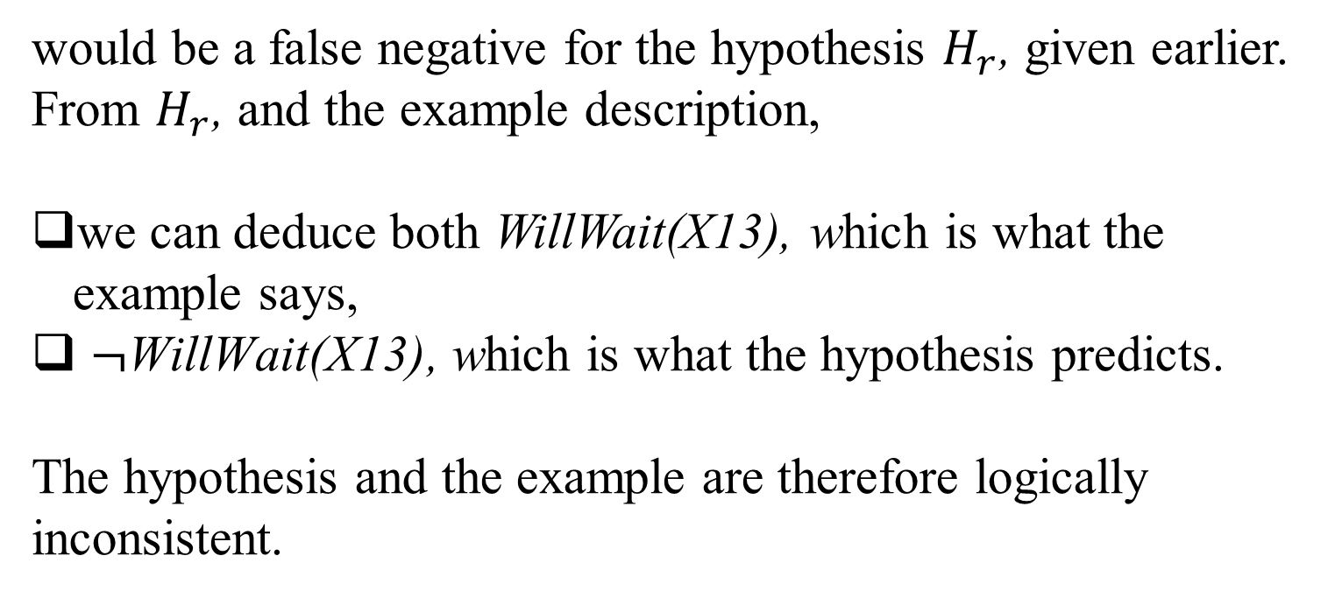
Learning logicial descripciones
An example can be a false negative for the hypothiesis, if the hypothesis says it should
be negative but in fact it is positive. For instance, the new example XI3 described by
would be a false negative for the hypothesis $H_{r}$, given earlier. From $H_{r}$, and the example description,
we can deduce both WillWait(X13), which is what the example says,
$¬\text{WillWait}\text{(}\text{X}\text{13)}$, which is what the hypothesis predicts.
The hypothesis and the example are therefore logically inconsistent.

Slide 14
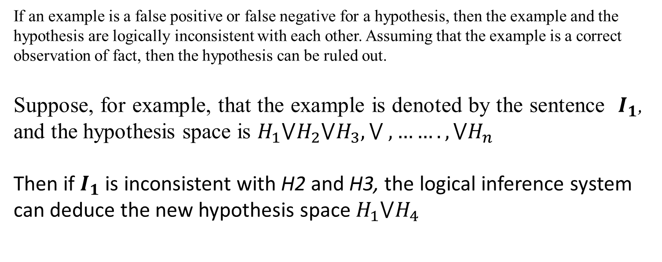
Hypothesis and Hypothesis Space
If an example is a false positive or false negative for a hypothesis, then the example and the
hypothesis are logically inconsistent with each other. Assuming that the example is a correct
observation of fact, then the hypothesis can be ruled out.
Suppose, for example, that the example is denoted by the sentence $I_{1}$, and the hypothesis space is $H_{1}⋁H_{2}⋁H_{3},⋁ ,…….,⋁H_{n}$
Then if $I_{1}$ is inconsistent with H2 and H3, the logical inference system can deduce the new hypothesis space $H_{1}⋁H_{4}$

Slide 15
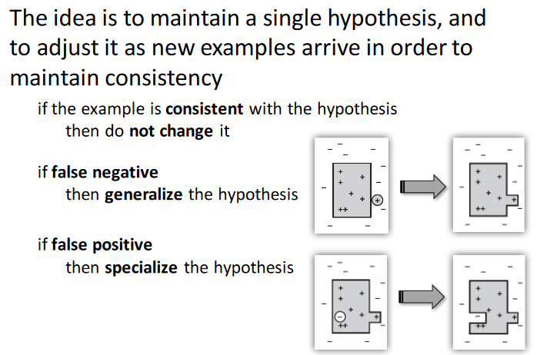
Definitions

Slide 16
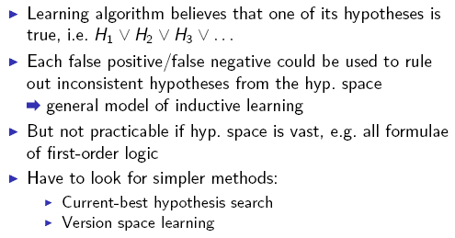

Slide 17
Current-Best Hypothesis Search
Idea very simple: adjust hypothesis to maintain consistency with examples and maintain a single hypothesis
Uses specialization/generalisation of current hypothesis to exclude false positives/include false negatives.
Assumes “more general than” and “more specific than” relations to search hypothesis space efficiently

Slide 18
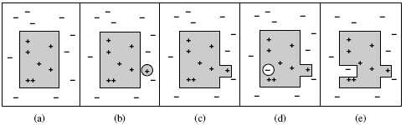
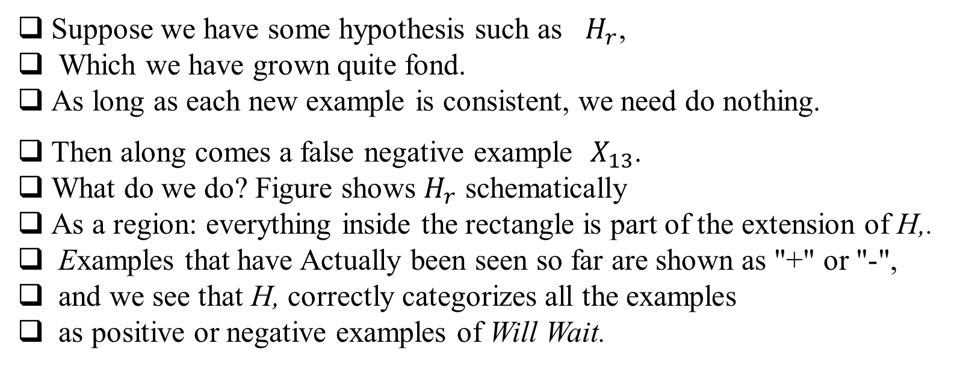
Current-Best Hypothesis Search
Suppose we have some hypothesis such as $H_{r}$,
Which we have grown quite fond.
As long as each new example is consistent, we need do nothing.
Then along comes a false negative example $X_{13}$.
What do we do? Figure shows $H_{r}$ schematically
As a region: everything inside the rectangle is part of the extension of H,.
Examples that have Actually been seen so far are shown as "+" or "-",
and we see that H, correctly categorizes all the examples
as positive or negative examples of Will Wait.

Slide 19
Current-Best Hypothesis Search
In Figure 19.l(b), (circled) is a false negative: the hypothesis says
it should be negative but it is actually positive.
The extension of the hypothesis must be increased to include it.
This is called generalization; one possible generalization is
shown in Figure 19.l(c).
Then in Figure 19.l(d), we see a false positive: the hypothesis says the
new example (circled) should be positive, but it actually is negative.
The extension of the hypothesis must be decreased to exclude the
example. This is called specialization;
in Figure 19.l(e) we see one possible specialization of the hypothesis.

Slide 20
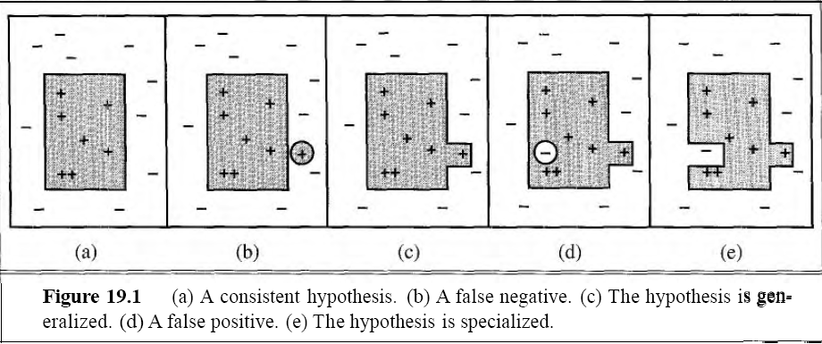
Current-Best Hypothesis Search
The "more general than" and "more specific than" relations between hypotheses provide the logical structure on the hypothesis space that makes efficient search possible.
We can now specify the CURRENT-B EST-LEARNING algorithm, shown in Figure 19.2. Notice that each time we consider generalizing or specializing the hypothesis, we must check for consistency with the other examples, because an arbitrary increase/decrease in the extension might include/exclude previously seen negative/positive examples.

Slide 21
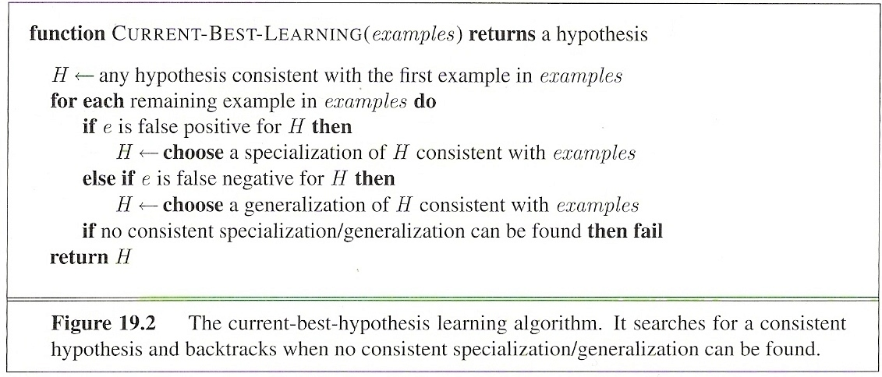
Current Best Hypothesis
Things to note:
Non-deterministic choice of specialization/generalisation
Does not provide rules for spec./gen.
One possibility: add/drop conditions

Slide 22
Current-best-hypothesis Search
1. Pick a random example to define the initial hypothesis
2. For each example,
–In case of a false negative:
•Generalize the hypothesis to include it
–In case of a false positive:
•Specialize the hypothesis to exclude it
3. Return the hypothesis

Slide 23
Current-best-hypothesis search
We have defined generalization and specialization as operations that change the extension of a hypothesis.
Now we need to determine exactly how they can be implemented as syntactic operations that change the candidate definition associated with the hypothesis,
So that a program can carry them out.
This is done by first noting that generalization and Specialization are also logical relationships between hypotheses

Slide 24
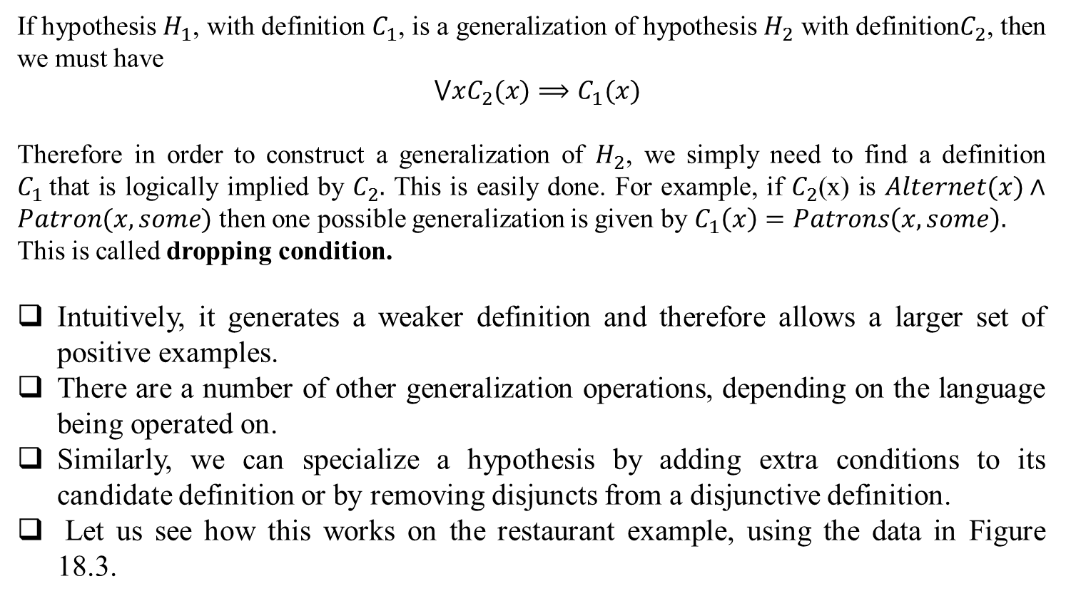
Current-best-hypothesis search
If hypothesis $H_{1}$, with definition $C_{1}$, is a generalization of hypothesis $H_{2}$ with definition$C_{2}$, then we must have
$$⋁xC_{2}(x)⟹C_{1}(x)$$
Therefore in order to construct a generalization of $H_{2}$, we simply need to find a definition $C_{1}$that is logically implied by $C_{2}.$ This is easily done. For example, if $C_{2}$(x) is $Alternet(x)∧Patron(x,some)$ then one possible generalization is given by $C_{1}\left(x\right)=Patrons\left(x,some\right).$
This is called dropping condition.
Intuitively, it generates a weaker definition and therefore allows a larger set of positive examples.
There are a number of other generalization operations, depending on the language being operated on.
Similarly, we can specialize a hypothesis by adding extra conditions to its candidate definition or by removing disjuncts from a disjunctive definition.
Let us see how this works on the restaurant example, using the data in Figure 18.3.

Slide 25
Hypothesis

Slide 26
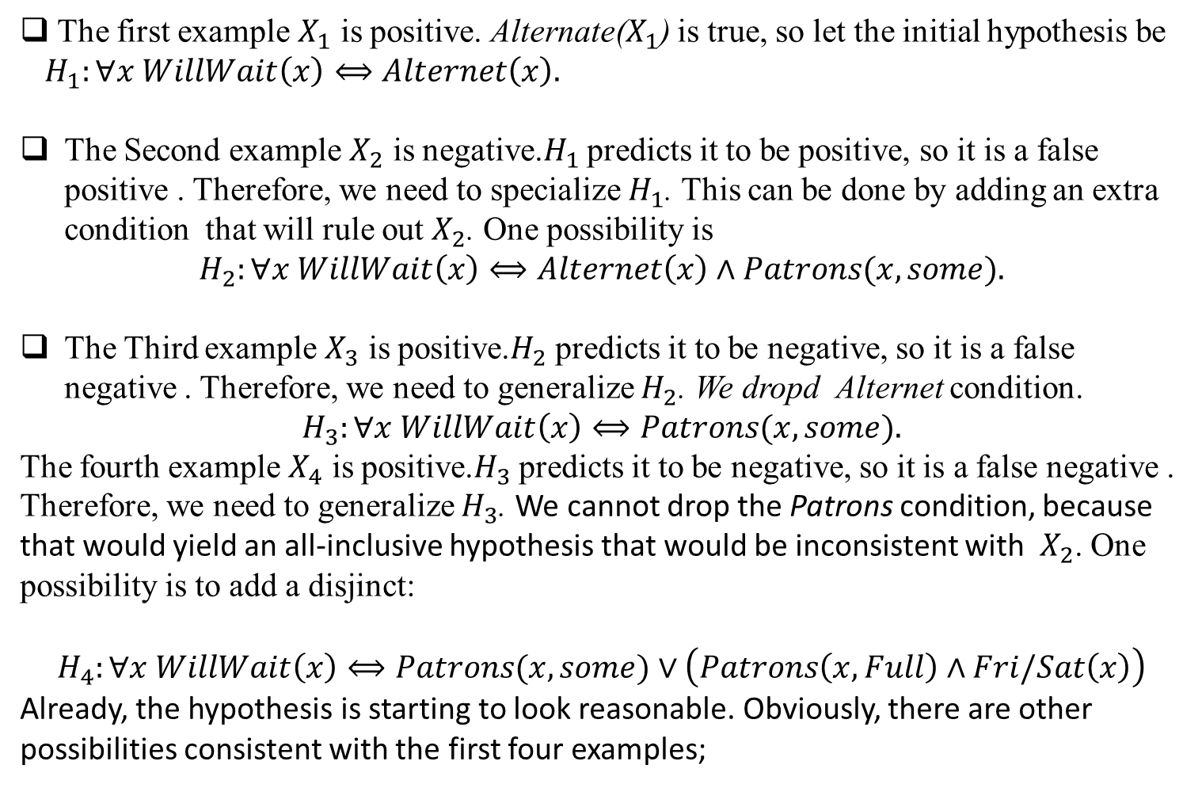
Current-best-hypothesis search
The first example $X_{1}$ is positive. Alternate($X_{1}$) is true, so let the initial hypothesis be
$H_{1}:∀x WillWait\left(x\right)⟺Alternet\left(x\right).$
The Second example $X_{2}$ is negative.$H_{1}$ predicts it to be positive, so it is a false positive . Therefore, we need to specialize $H_{1}$. This can be done by adding an extra condition that will rule out $X_{2}$. One possibility is
$$H_{2}:∀x WillWait\left(x\right)⟺Alternet\left(x\right)∧Patrons(x,some).$$
The Third example $X_{3}$ is positive.$H_{2}$ predicts it to be negative, so it is a false negative . Therefore, we need to generalize $H_{2}$. We dropd Alternet condition.
$$H_{3}:∀x WillWait\left(x\right)⟺Patrons(x,some).$$
The fourth example $X_{4}$ is positive.$H_{3}$ predicts it to be negative, so it is a false negative . Therefore, we need to generalize $H_{3}$. We cannot drop the Patrons condition, because
that would yield an all-inclusive hypothesis that would be inconsistent with $X_{2}$. One possibility is to add a disjinct:
$$H_{4}:∀x WillWait\left(x\right)⟺Patrons(x,some)∨\left(Patrons\left(x,Full\right)∧Fri/Sat\left(x\right)\right)$$
Already, the hypothesis is starting to look reasonable. Obviously, there are other possibilities consistent with the first four examples;

Slide 27

Current-best-hypothesis search
Here are two of them:
The CURRENT-BEST-LEARNING algorithm is described non-deterministically, because at any point, there may be several possible specializations or generalizations that can be applied. The choices that are made will not necessarily lead to the simplest hypothesis, and may lead to an unrecoverable situation where no simple modification of the hypothesis is consistent with all
of the data. In such cases, the program must backtrack to a previous choice point

Slide 28
Current-best-hypothesis search
Some difficulties arise:
Checking all the previous instances over again for each modification is very expensive.
2. The search process may involve a great deal of backtracking. Hypothesis space can be a doubly exponentially large place.

Slide 29
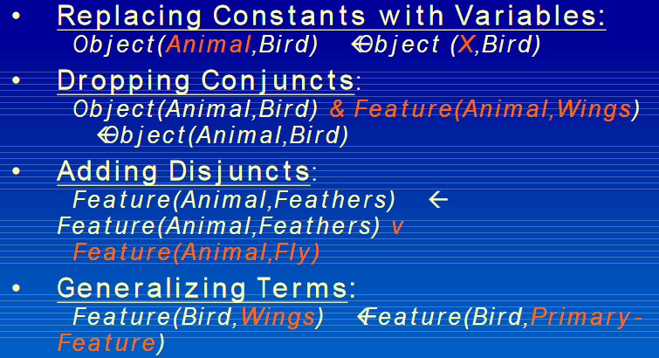
How to Generalize

Slide 30
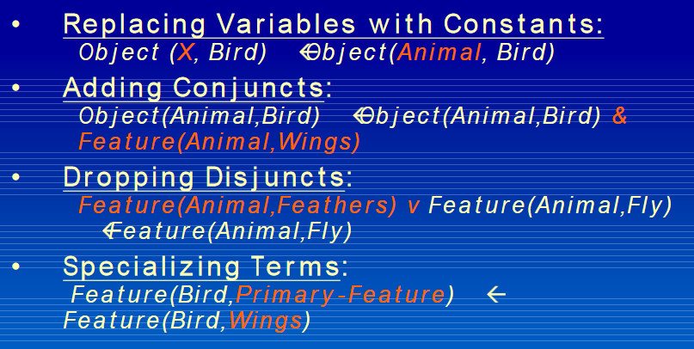
How to Specialize

Slide 31
Generalize and Specialize
Must be consistent with all other examples
Non-deterministic
–At any point there may be several possible specializations or generalizations that can be applied

Slide 32
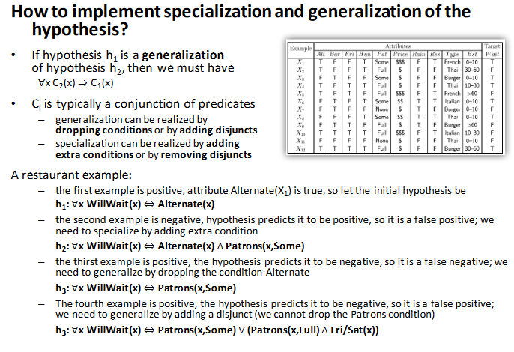
How to implement specialization and generalization of the hypothesis?

Slide 33
Potential Problem of Current- best-hypothesis Search
Have to check all examples again after each modification
Involves great deal of backtracking
Extension made not necessarily lead to the simplest hypothesis.
May lead to an unrecoverable situation where no simple modification of the hypothesis is consistent with all of the examples.
The program must backtrack to a previous choice point
Alternative: maintain set of all hypotheses consistent with
examples

Slide 34
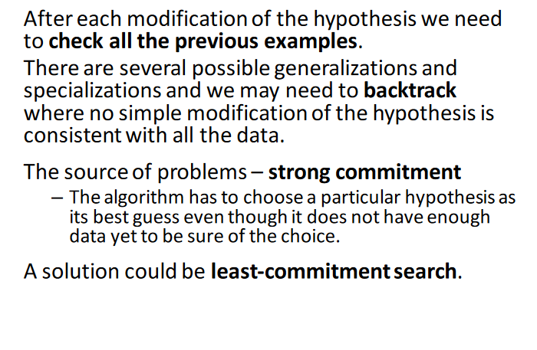
Potential Problem of Current- best-hypothesis Search

Slide 35
Least-commitment search
Backtracking arises because the current-best-hypothesis approach has to choose a particular hypothesis as its best guess even though it does not have enough data yet to be were of the choice.
Incremental approach such that consistency
is guaranteed without backtracking
• Partial ordering on the hypothesis space
– Generalization/specialization
– G-set, most general boundary
– S-set, most specific boundary

Slide 36
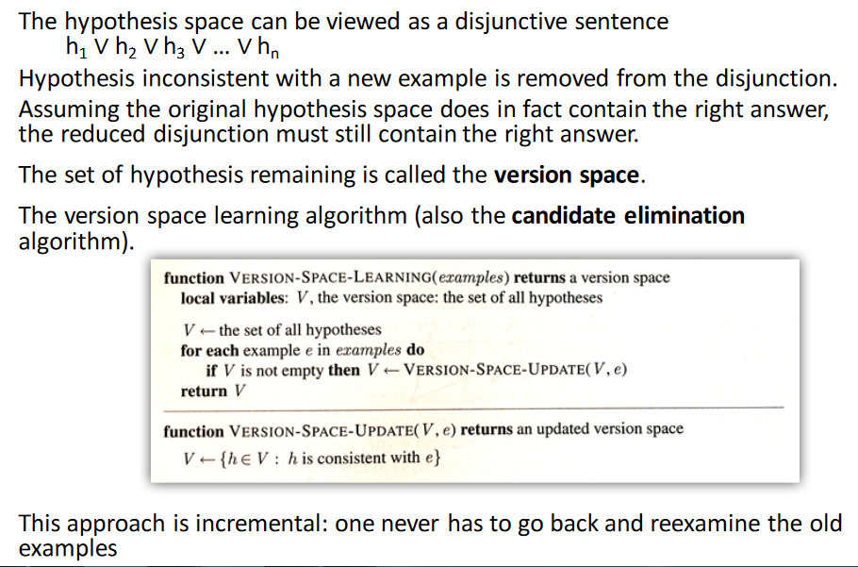
Least-commitment search

Slide 37
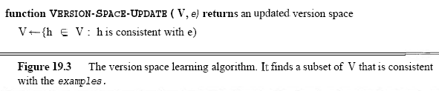
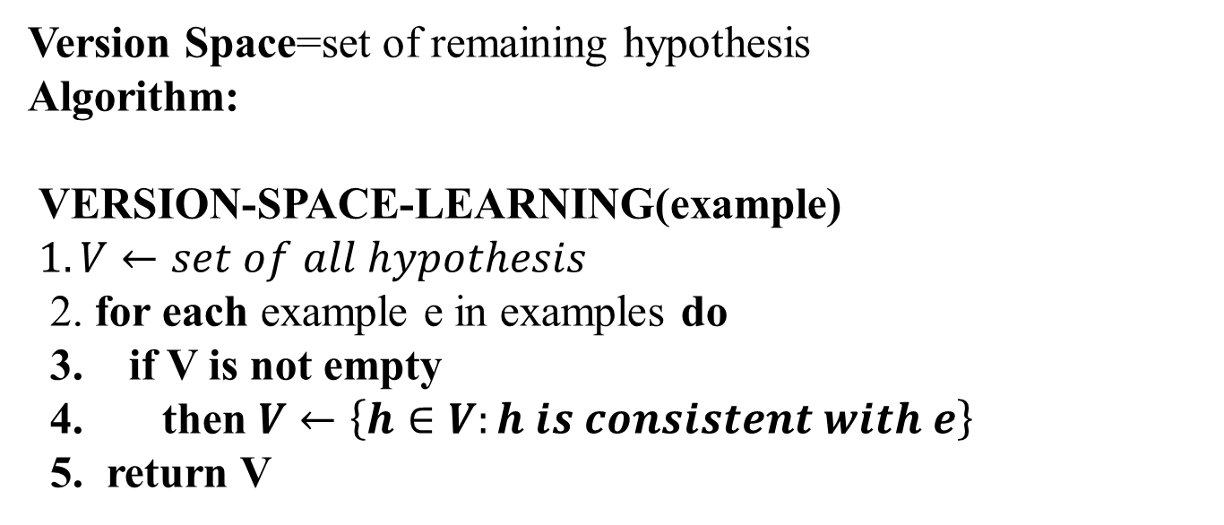
Least-commitment search
Version Space=set of remaining hypothesis
Algorithm:
VERSION-SPACE-LEARNING(example)
$1. V←set of all hypothesis$
2. for each example e in examples do
3. if V is not empty
4. then $V←\left\{h∈V:h is consistent with e\right\}$
5. return V

Slide 38
Least-commitment search
One important property of this approach is that it is incremental: one never has to
go back and reexamine the old examples.
All remaining hypotheses are guaranteed
to be consistent with them anyway.
It is also a least-commitment algorithm because it makes no arbitrary choices

Slide 39
Least-commitment search
Version Space Learning
Advantage:
Incremental approach (don’t have to consider old examples again)
Least-commitment algorithm
Problem: How to write down disjunction of all hypotheses?
think of interval notation [1, 2]
Exploit ordering on hypotheses and boundary sets
G-set most general boundary (no more general hypotheses are consistent with all examples)
S-set most specific boundary (no more specific hypotheses are consistent with all examples)

Slide 40
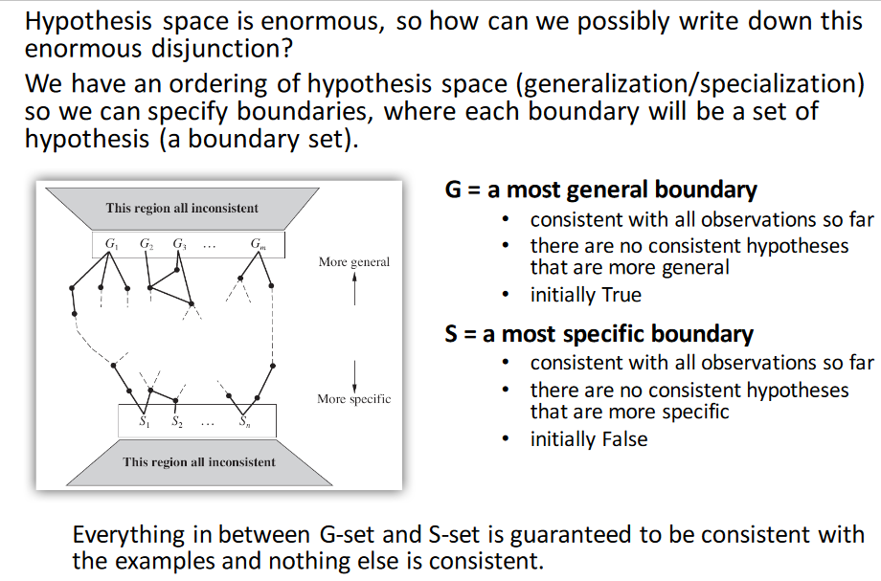
Least-commitment search

Slide 41
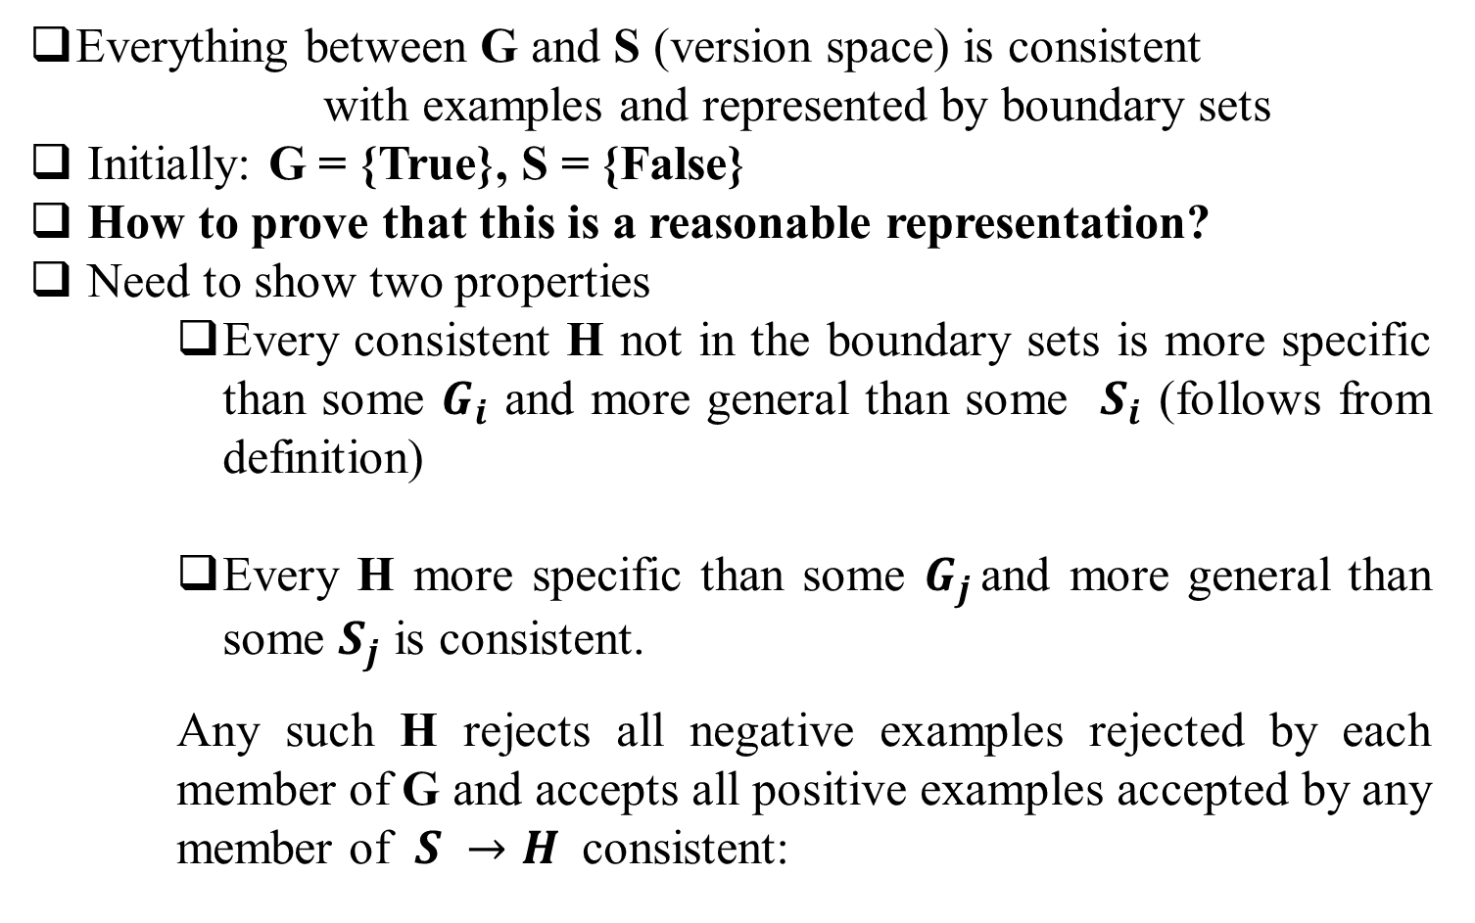
Version Space Learning
Everything between G and S (version space) is consistent
with examples and represented by boundary sets
Initially: G = {True}, S = {False}
How to prove that this is a reasonable representation?
Need to show two properties
Every consistent H not in the boundary sets is more specific than some $G_{i}$ and more general than some $S_{i}$ (follows from definition)
Every H more specific than some $G_{j }$and more general than some $S_{j}$ is consistent.
Any such H rejects all negative examples rejected by each member of G and accepts all positive examples accepted by any member of $S →H$ consistent:

Slide 42
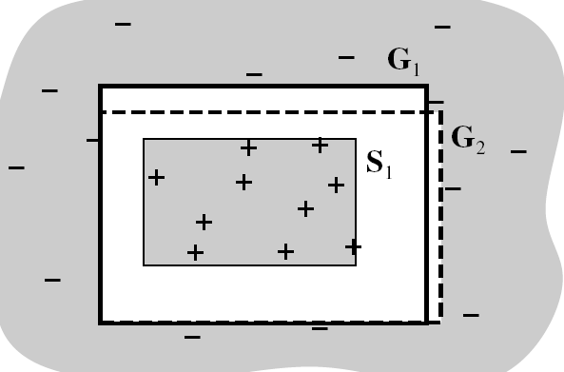
Version Space Learning
There are no known examples “between” S and G, i.e. outside S but inside G:

Slide 43
Summary
How to deal with knowledge-based representations of inductive learning?
Described DTL in terms of logic
Introduced current-best learning (problems: backtracking, non-incremental)
Version spaces as an incremental method of inductive learning
Next time: Knowledge Representation & Reasoning

